Slide 1
Genetics and Heredity
Thanks to Mr. Gagnon
https://sites.google.com/a/pemibaker.org/mr-gagnons-site/8th-grade-science-6-genetics-heredity

Slide 2
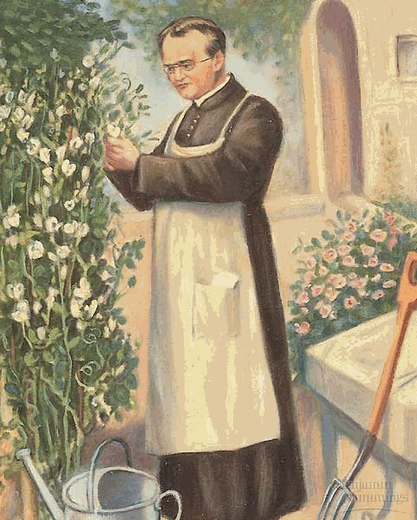
3.1 Mendel’s Work
3.2 Probability and Genetics
Key Terms:
  Traits
  Heredity
  Genetics
  Purebred
  Genes
  Alleles
  Recessive Allele
  Dominant Allele
  Hybrids
Key Concepts:
  What factors control the inheritance of traits in organisms?

Slide 3

History of Genetic Inheritance
Gregor Mendel, a young priest, was a student of math and science.
1853 he lived in a monastery tending the pea plants.
Mendel realized the pea plants had different physical characteristics or traits.
Why would some pea plants make green or yellow seeds?
Mendel recognized that these traits were passed down from a parent plant, heredity.
This theory was the foundation of what we know as genetics, the scientific study of heredity.

Slide 4
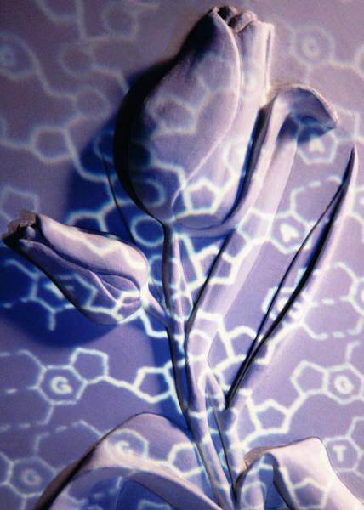
Mendel’s Experiments:
Mendel started his experiments with purebred plants, plants that always produced offspring with the same traits as the parent.
An organism with 2 identical alleles (forms of a gene, one member of a pair) are called homozygous.
An organism that has 2 different alleles (forms of a gene, one member of a pair) in a genotype are heterozygous.
Mendel cross-pollinated purebred tall plants with purebred short plants.

Slide 5
Mendel’s Results:
Parent Generation (P) | 1st Offspring Generation (F₁) | 2nd Offspring Generation (F₂)
1 Tall 1 Short | 2 Tall | 3 Tall 1 Short
Crossed
Crossed
How Could This Happen?

Slide 6
Punnett Square
Homozygous Tall (TT)
T
T
Tt
Tt
t
Each offspring receives 1 allele from each parent.
A cross between 2 homozygous parents (1 parent dominant, 1 recessive) creates 4 hybrid offspring (all possessing dominant phenotypes).
Homozygous Short (tt)
Tt
Tt
t

Slide 7
Punnett Square
Heterozygous Tall (Tt)
T
t
TT
Tt
T
Each offspring receives 1 allele from each parent.
A cross between 2 heterozygous parents creates 3 tall plants (1-TT, 2 Tt) and 1 short plant (tt).
Heterozygous Tall (Tt)
Tt
tt
t

Slide 8
Mendel’s Conclusions:
Individual factors must control inheritance of traits in peas.
The factors that control each trait exists in pairs.
The female parent contributes one portion and the male the other.
He also concluded that one factor in a pair can mask, or hide, the other factor (tall pea plant).

Slide 9
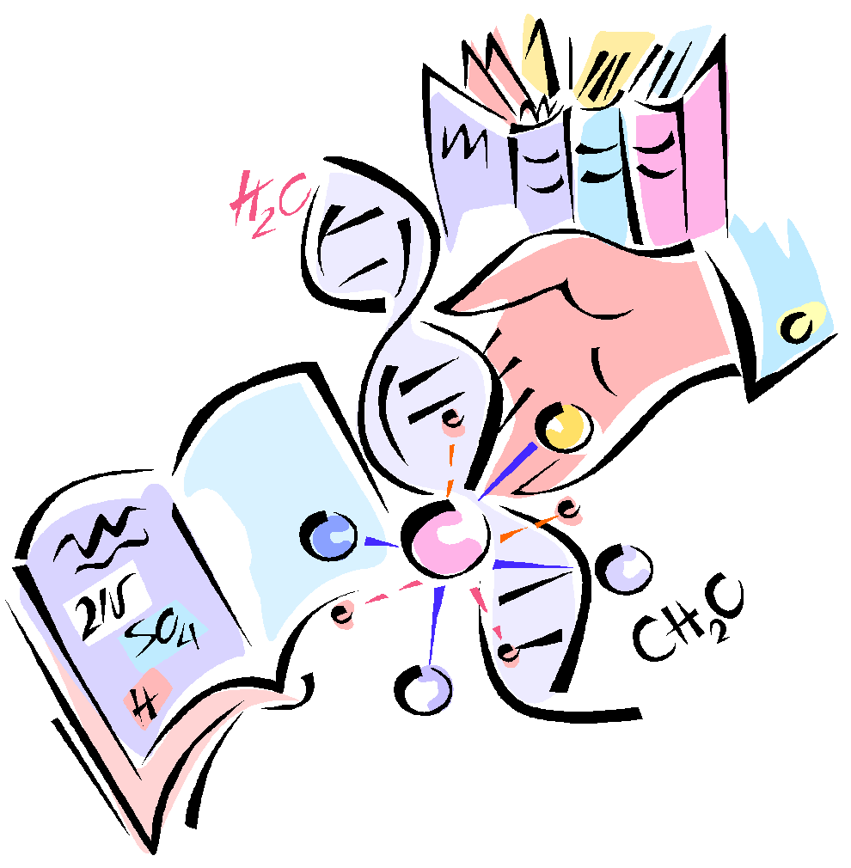
Modern Science:
Genotype:
Phenotype:
Genotype – is the genetic makeup of the organism.
Genotype- is the combination of alleles
Alleles are the different forms of the genes represented by capital and lower case letters.
The physical traits and appearances.
Phenotype- is what the genotype looks like
Tall/short, green/yellow, etc.

Slide 10
Types of Alleles:
Dominant Alleles are the genetic trait that will always show (tall over short pea plants).
The dominant allele will show in its phenotype.
Recessive Alleles are the genetic traits that are hidden unless paired with another recessive trait (short pea plant).

Slide 11
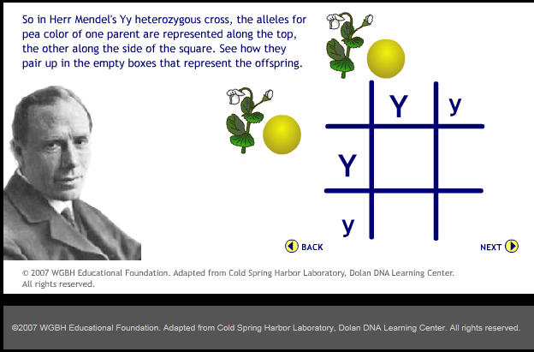
Mendelian Genetics
http://www.teachersdomain.org/asset/hew06_int_mendelinherit/

Slide 12
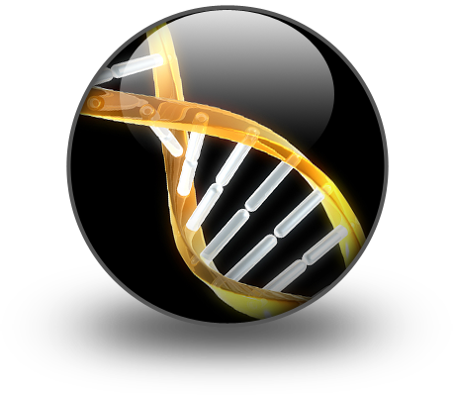
Recapitulation:
Offspring receive an allele from each parent.
If both parents are purebreds (1 dominant, 1 recessive) the offspring is a hybrid.
Mendel wrote his observations in a scientific paper in 1866.
It went ignored for 34 years, until scientists proved his theories correct.
Mendel is called the “Father of Genetics”.

Slide 13
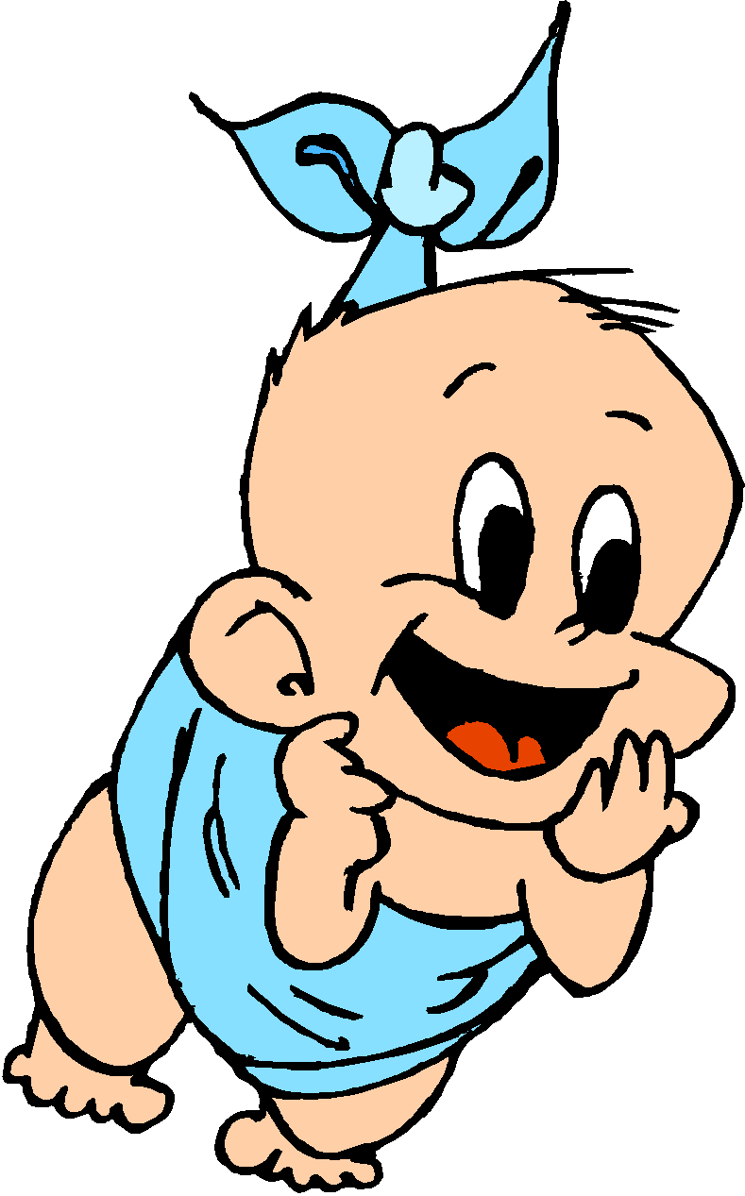
Were These Babies Switched?

Slide 14
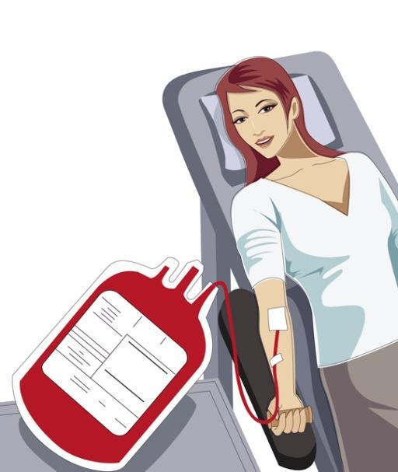
Blood Type Investigations
All humans have a blood phenotype of Types A, B, AB, or o.
      Type A (I^{A}I^{A} ,or I^{A}i)
      Type B (I^{B}I^{B} ,or I^{B}i)
      Type AB (I^{A}I^{B})
      Type o (ii)
Allele A and B are codominant, which creates the type AB blood.

Slide 15
Cell Theory
The cell theory states that:
  All living things consist of cells.
  Cells are the basic unit of structure and function in living things.
  All cells are produced from other cells.

Slide 16
Organelles
Nucleus- the “brain” of the cell.
Cell Wall- surrounds the cell, a barrier found mostly in plants.
Cell membrane- acts as a filter for all cells.
Chromatin- contain genetic material that instructs the function of the cell.
Nucleolus- creates ribosomes.
Ribosomes- protein synthesis (creation).

Slide 17
Organelles cont.
Mitochondria- the “powerhouse” of the cell.
Endoplasmic Reticulum – Passageways carrying materials for the cell.
Rough or Smooth ER- Rough Endoplasmic Reticulum (RER) have ribosomes, Smooth Endoplasmic Reticulm (SER) do not.
Golgi Bodies- Package and deliver material throughout the cell.
Chloroplasts- capture energy from the sun and produces food for plant cells.
Vacuoles- storage area.
Lysosome- contain enzymes that break down large food particles into smaller ones.

Slide 18
Cell Replication
Mitosis
1 mother cell creates 1 identical daughter cell.
DNA is exactly the same.
Mother cell has = amount of DNA as daughter cell.
Meiosis
1 mother cell creates 4 gametes.
DNA is different between mother and daughter cells.
Gametes have ½ the DNA of the mother cell.

Slide 19
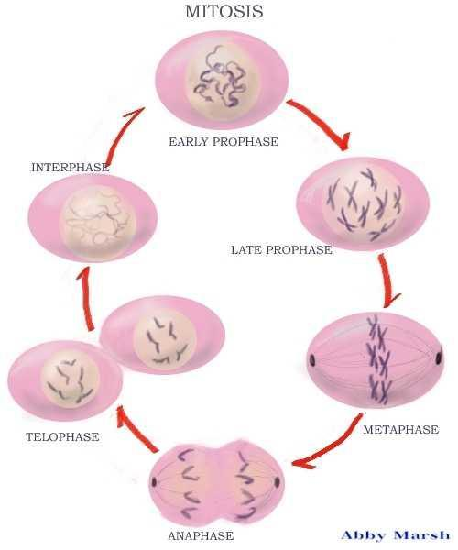
Stages of Mitosis
Interphase
S-Phase (Synthesis)
Prophase
Metaphase
Anaphase
Telophase

Slide 20
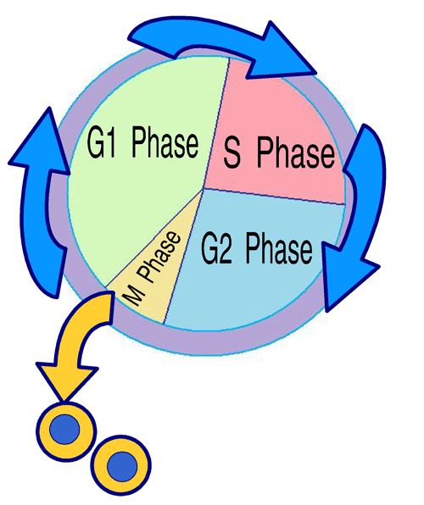
Interphase
During interphase:
  There are 3 stages (G1, S-phase, and G2)
  The G stands for Gap and preparation for the next stage is occurring during these stages.
  The S-Phase stands for synthesis.

Slide 21
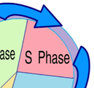
S-Phase
During S-Phase:
  DNA is being duplicated (doubled).
  Synthesis means to create.
  This is what makes the cell capable of splitting in half to make 2 cells.

Slide 22
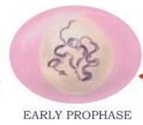
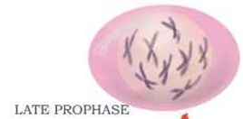
Prophase
During prophase:
  Chromatin condenses and becomes chromosomes.
  Chromosomes have 2 strands.
  1 strand is called a chromatid.
  Nuclear envelope begins to disappear.
  Chromosomes move towards the center.

Slide 23
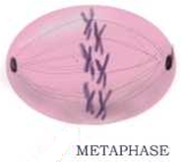
Metaphase
During metaphase:
  Chromosomes are aligned in the center (metaphase plate).
  Chromosomes are most dense at this point.

Slide 24
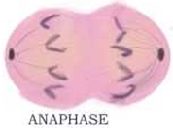
Anaphase
During anaphase:
  Chromosomes are broken at the center (centromere).
  The chromatids polarize (go to opposite sides).
  The center of the cell begins to pinch.

Slide 25
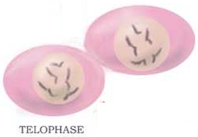
Telophase
During telophase:
  The pinch becomes a clear separation.
  The 1 mother cell has now become 2 daughter cells.
  Both cells have the same DNA.

Slide 26
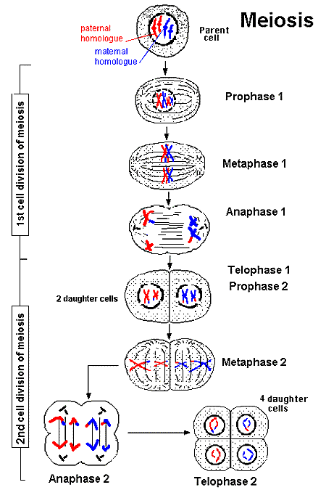
Stages of Meiosis
1st Cell Division:
1. Prophase I
2. Metaphase I
3. Anaphase I
4. Telophase I
2nd Cell Division:
1. Prophase II
2. Metaphase II
3. Anaphase II
4. Telophase II
5. 4-daughter cells with ½ the DNA.

Slide 27
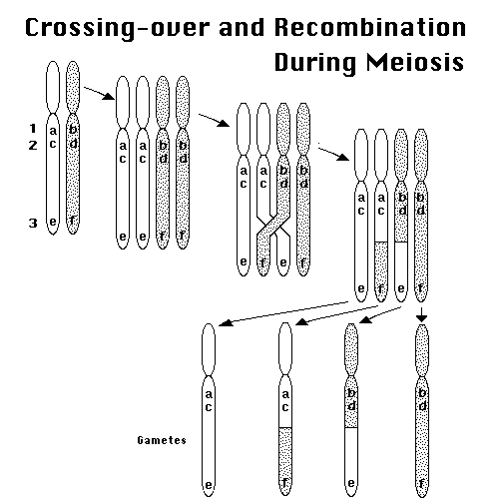
Crossing Over
Crossing over is one reason for genetic variation within meiosis.
Genes “cross-over” from one chromatid to the other.

Slide 28
Genetic Code
Proteins determine the size, shape, and other traits of an organism.
Genetic code is similar to Morse Code.
The cell needs to interpret and replicate the genetic code to complete the cells tasks.
DNA Molecules are made up of 4 different nitrogenic bases:
  A- Adenine
  T- Thymine
  G- Guanine
  C- Cytosine
The order of these nitrogen bases specifies what type of protein is produced.

Slide 29
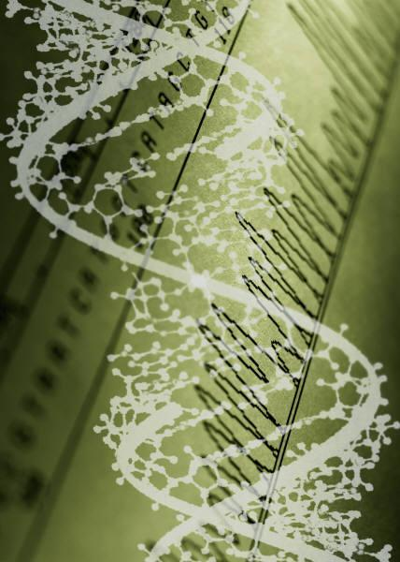
3.4 The DNA Connection

Slide 30
Genetic Translation
The nitrogen bases pair up with each other to form the well know matrix (spiraling staircase).
Adenine-Thymine
Guanine-Cytosine
DNA needs a “messenger” to tell the ribosomes to create a type of protein.

Slide 31
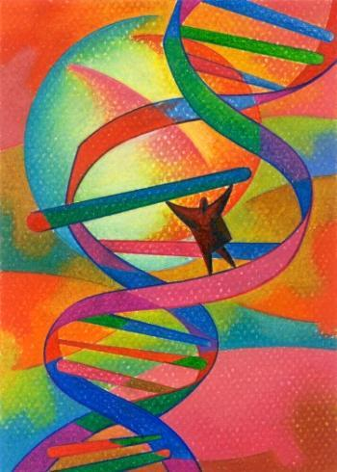
Messenger RNA
Messenger RNA copies the coded message found in the DNA, and sends it throughout the cell.
To do this, the DNA is laid out and “unzipped”.
The mRNA pairs nitrogen bases with the DNA to get a replica copy (silly putty imprint).
Uracil replaces thymine.
A-U
G-C

Slide 32
Transfer RNA
Transfer RNA are used to carry the genetic code in small sections.
tRNA “transfers” 3-letter codes that are attached to an amino acid.
All of these amino acids are chained together to form a protein.
The protein continues until there is a “stop” code.
The process started with a “start” code.

Slide 33
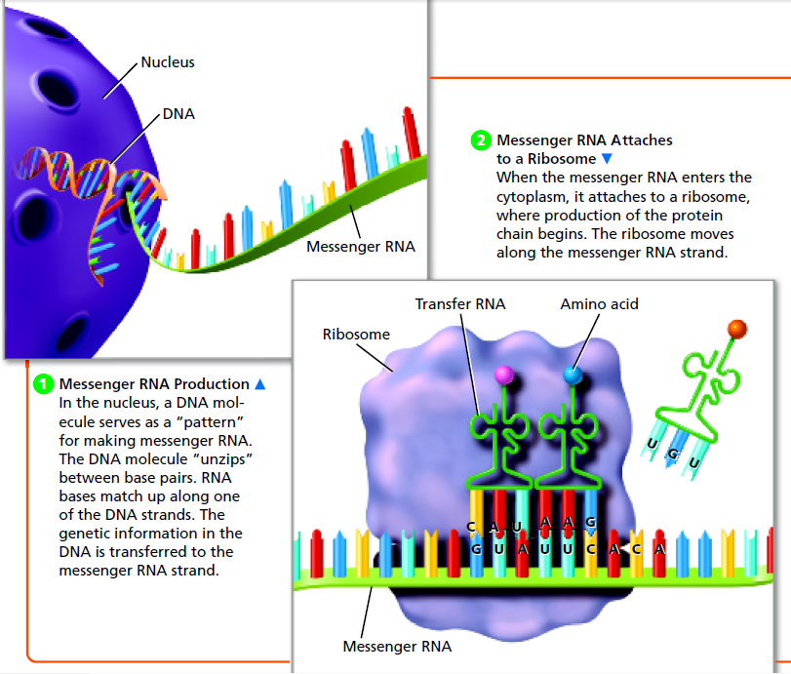
Protein Synthesis

Slide 34
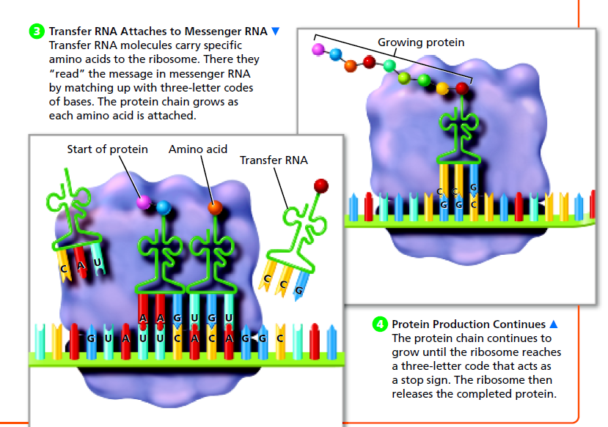
Protein Synthesis cont.

Slide 35
Mutations
Mutations can occur in the nitrogen bases during the translation process.
Any mutations can create a change in that particular cell.
If the mutation occurs in a sex cell, this could affect the offspring and the offspring’s phenotype.

